Slide 1

HEARTBEAT MONITORING SYSTEM
Done by
Nivedhidha I (E0220003)

Slide 2
PROBLEM STATEMENT
Presently monitoring health is a complex matter
Involves high tech and isn't handy
Older methods are expensive and not accessible by all
E.g.: Electrocardiogram (ECG)

Slide 3
solution
To design and fabricate patient monitoring system for monitoring Heart Rate signal.
Main Objectives Of The Project:
User friendly
Compact
Efficient
Inexpensive alternative to Heart Rate Monitors

Slide 4
Skills learnt
Learnt Soldering
Learnt about each component and how to handle them
Learnt programming in Arduino for the parts used in the project
Learnt about pulse module and KY-039 sensor

Slide 5
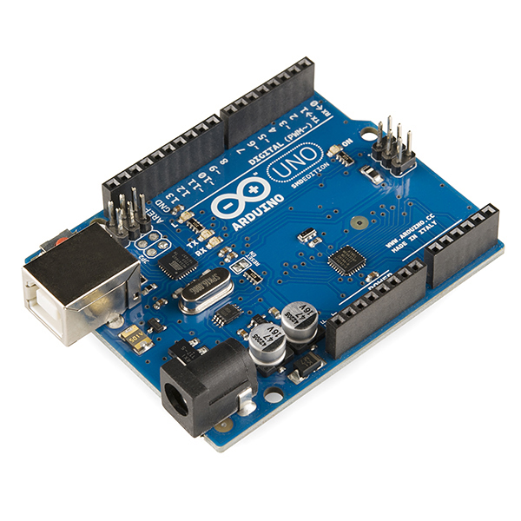

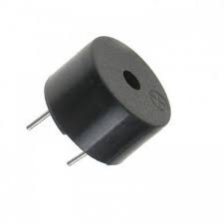
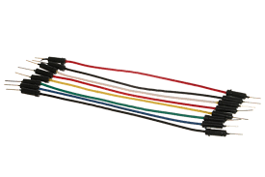
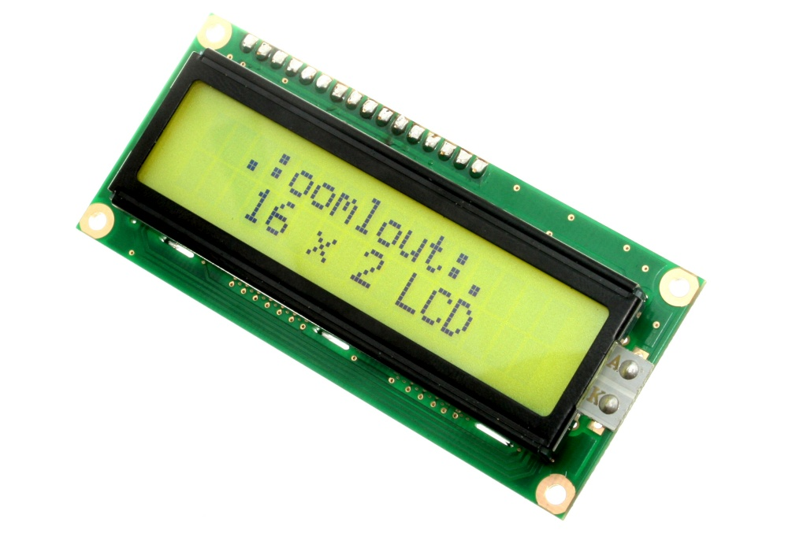
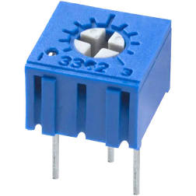
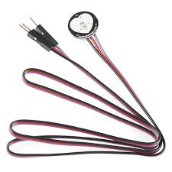
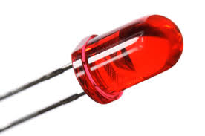
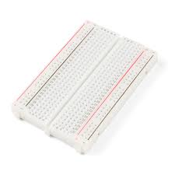
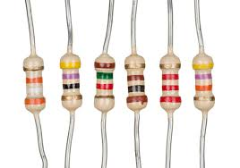
ARDUINO UNO R3 9V BATTERY BUZZER JUMPER WIRES
COMPONENTS
LCD DISPLAY
POTENTIOMETER 10K
PULSE MODULE RED LED RESISTORS BREAD BOARD

Slide 6
Pulse Sensor
Consists a small Printed Circuit Board with an LED and an ambient light sensor
Ambient light sensor detects heart beats based on reflections of light
Once placed above a vein in a human body, LED starts emitting light
Change in volume between heartbeats affects the amount of light
Change in volume of blood in capillary tubes between two consecutive heartbeats detected by Pulse sensor
The minute difference can be calculated using Arduino

Slide 7
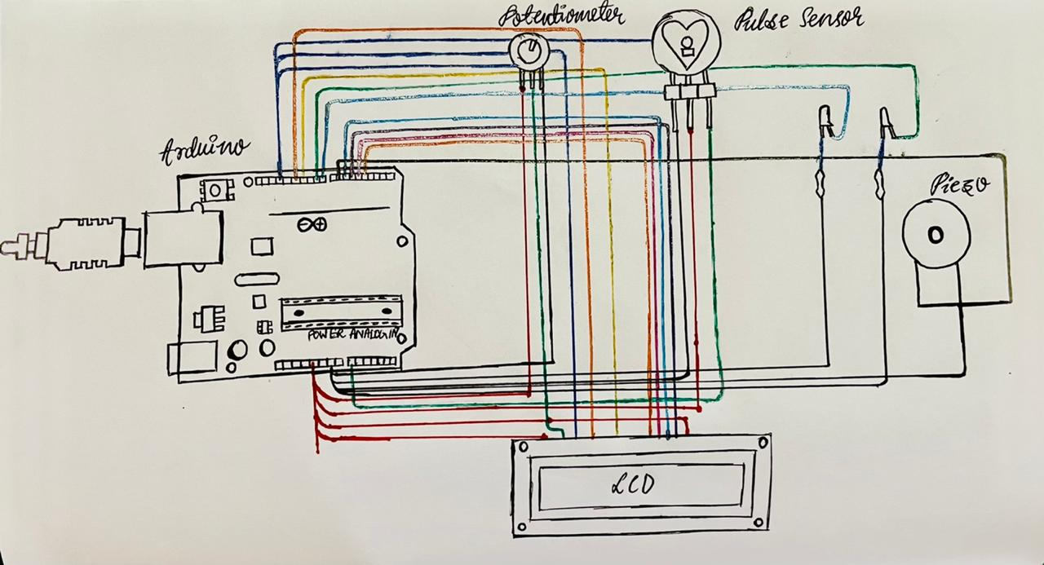
Block diagram

Slide 8


TOOLS AND TECHNOLOGY
TINKERCAD - Simulation of the application
ARDUINO - IDE used to run the code

Slide 9
Working methodology
A finger is placed on the sensor
LED starts emitting the light
Ambient light sensor receives the reflected light
Variation of light is obtained as a pulse
When abnormality observed,
Buzzer makes sound
LCD displays emergency
LED glows

Slide 10
Expected results During abnormality
Heart rate displayed on LCD panel
Emergency is displayed
Buzzer makes sound

Slide 11
Future scope
WIFI module to be added:
To call and inform the family member if emergency
To connect it to a database for noting change in heart rate
Upgrade this into pulse oximeter

Slide 12
Challenges faced
Coding part of the Pulse Sensor Module
Changing Contrast of the LCD panel
Understanding how pulse sensor works

Slide 13
REFERENCES
hackerearth.com
generationrobots.com
engineersgarage.com
circuitstoday.com
create.arduino.cc/projecthub
electronicshub.org
pulsesensor.com

Slide 14
THANK YOU

